Slide 1
Implications of Having a Distributed Database
Part One

Slide 2
Objective
A distributed environment has an impact on the way:
  concurrency control,
  recovery and
  query processing is undertaken(compared to a centralized environment).
This lecture highlights some of the problems and the way around the same.

Slide 3
Distributed Transaction Management
Transaction may access data at several sites.
Each site has a local transaction manager responsible for:
  Participating in coordinating the concurrent execution of the transactions executing at that site.
  Maintaining a log for recovery purposes
Each site has a transaction coordinator, which is responsible for:
  Starting the execution of transactions that originate at the site.
  Distributing sub-transactions at appropriate sites for execution.
  Coordinating the termination of each transaction that originates at the site, which may result in the transaction being committed at all sites or aborted at all sites.

Slide 4
System Failure Modes
Failures unique to distributed systems:
  Failure of a site.
  Loss of messages
    Handled by network transmission control protocols such as TCP-IP
  Failure of a communication link
    Handled by network protocols, by routing messages via alternative links
  Network partition
    A network is said to be partitioned when it has been split into two or more subsystems that lack any connection between them
      Note: a subsystem may consist of a single node
Network partitioning and site failures are generally indistinguishable.

Slide 5
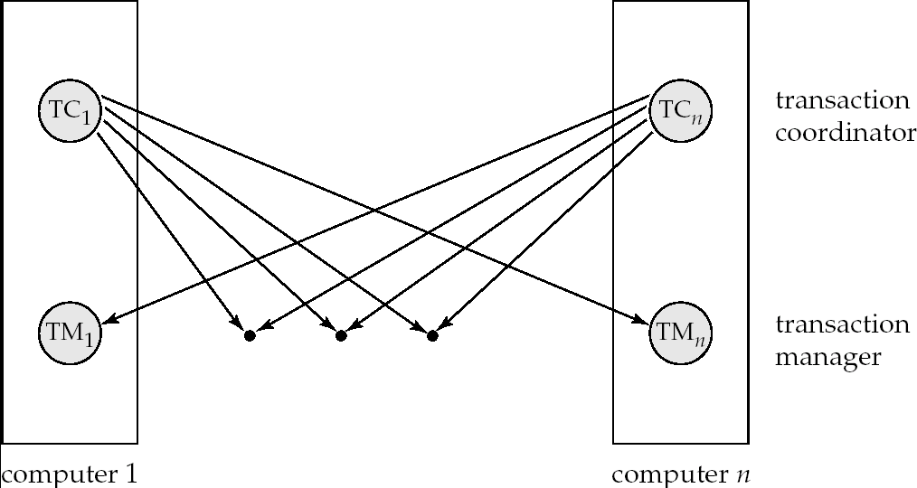
Transaction System Architecture

Slide 6
Commit Protocols
Commit protocols are used to ensure atomicity across sites
  a transaction which executes at multiple sites must either be committed at all the sites, or aborted at all the sites.
  not acceptable to have a transaction committed at one site and aborted at another
The two-phase commit (2PC) protocol is widely used
The three-phase commit (3PC) protocol is more complicated and more expensive, but avoids some drawbacks of two-phase commit protocol. This protocol is not used in practice.

Slide 7
Two Phase Commit Protocol (2PC)
Assumes fail-stop model – failed sites simply stop working, and do not cause any other harm, such as sending incorrect messages to other sites.
Execution of the protocol is initiated by the coordinator after the last step of the transaction has been reached.
The protocol involves all the local sites at which the transaction executed
Let T be a transaction initiated at site S_{i}, and let the transaction coordinator at S_{i} be C_{i}

Slide 8
Phase 1: Obtaining a Decision
Coordinator C_{i} asks all participants to prepare to commit transaction T_{i}.
  C_{i} adds the records <prepare T> to the log and forces log to stable storage
  sends prepare T messages to all sites at which T executed
Upon receiving message, transaction manager at each site determines if it can commit the transaction
  if not, adds a record <no T> to the log and sends abort T message to C_{i}
  if the transaction can be committed, then:
  adds the record <ready T> to the log
  forces all records for T to stable storage
  sends ready T message to C_{i}

Slide 9
Phase 2: Recording the Decision
T can be committed if C_{i} received a ready T message from all the participating sites: otherwise T must be aborted.
Coordinator C_{i} adds a decision record, <commit T> or <abort T>, to the log and forces record onto stable storage. Once the record is on stable storage it is irrevocable (even if failures occur)
Coordinator C_{i} sends a message to each participant informing it of the decision (commit or abort)
Participants take appropriate action locally.

Slide 10
Handling of Failures - Site Failure
When site S_{k} recovers, it examines its log to determine the fate of
transactions active at the time of the failure.
Log contain <commit T> record: site executes redo (T)
Log contains <abort T> record: site executes undo (T)
Log contains <ready T> record: site must consult C_{i} to determine the fate of T.
  If T committed, redo (T)
  If T aborted, undo (T)
The log contains no control records concerning T means that S_{k} failed before responding to the prepare T message from C_{i}
  since the failure of S_{k} precludes the sending of such a
  response C_{i} must abort T
  S_{k} must execute undo (T)

Slide 11
Handling of Failures- Coordinator Failure
If coordinator C_{i} fails while the commit protocol for T is executing then participating sites must decide on T’s fate:
  If an active site contains a <commit T> record in its log, then T must be committed.
  If an active site contains an <abort T> record in its log, then T must be aborted.
  If some active participating site does not contain a <ready T> record in its log, then the failed coordinator C_{i} cannot have decided to commit T. Can therefore abort T.
  If none of the above cases holds, then all active sites must have a <ready T> record in their logs, but no additional control records (such as <abort T> of <commit T>). In this case active sites must wait for C_{i} to recover, to find decision.
Blocking problem : active sites may have to wait for failed coordinator C_{i} to recover.

Slide 12
Handling of Failures - Network Partition
If the coordinator and all its participants remain in one partition, the failure has no effect on the commit protocol.
If the coordinator and its participants belong to several partitions:
  Sites that are not in the partition containing the coordinator think the coordinator has failed, and execute the protocol to deal with failure of the coordinator.
    No harm results, but sites may still have to wait for decision from coordinator.
The coordinator (and the sites that are in the same partition as the coordinator) think that the sites in the other partition have failed, and follow the usual commit protocol.
    Again, no harm results

Slide 13
Recovery and Concurrency Control
In-doubt transactions have a <ready T>, but neither a
<commit T>, nor an <abort T> log record.
  The recovering site must determine the commit-abort status of such transactions by contacting other sites; this can slow and potentially block recovery.
Recovery algorithms can note lock information in the log.
  Instead of <ready T>, write out <ready T, L> L = list of locks held by T when the log is written (read locks can be omitted).
  For every in-doubt transaction T, all the locks noted in the
  <ready T, L> log record are reacquired.
After lock reacquisition, transaction processing can resume; the commit or rollback of in-doubt transactions is performed concurrently with the execution of new transactions.

Slide 14
Alternative Models of Transaction Processing
Notion of a single transaction spanning multiple sites is inappropriate for many applications
  E.g. transaction crossing an organizational boundary
  No organization would like to permit an externally initiated transaction to block local transactions for an indeterminate period
Alternative models carry out transactions by sending messages
  Code to handle messages must be carefully designed to ensure atomicity and durability properties for updates
    Isolation cannot be guaranteed, in that intermediate stages are visible, but code must ensure no inconsistent states result due to concurrency
  Persistent messaging systems are systems that provide transactional properties to messages
    Messages are guaranteed to be delivered exactly once

Slide 15
Alternative Models (Cont.)
Motivating example: funds transfer between two banks
  Two phase commit would have the potential to block updates on the accounts involved in funds transfer
  Alternative solution:
    Debit money from source account and send a message to other site
    Site receives message and credits destination account
  Messaging has long been used for distributed transactions (even before computers were invented!)
Atomicity issue:
  Once transaction sending a message is committed, message must be guaranteed to be delivered
    Guarantee as long as destination site is up and reachable, code to handle undeliverable messages must also be available
      e.g. credit money back to source account.
  If sending transaction aborts, message must not be sent

Slide 16
Error Conditions with Persistent Messaging
Code to handle messages has to take care of variety of failure situations (even assuming guaranteed message delivery)
  E.g. if destination account does not exist, failure message must be sent back to source site
  When failure message is received from destination site, or destination site itself does not exist, money must be deposited back in source account
    Problem if source account has been closed
      get humans to take care of problem
User code executing transaction processing using 2PC does not have to deal with such failures

Slide 17
Persistent Messaging and Workflows
Workflows provide a general model of transactional processing involving multiple sites and possibly human processing of certain steps
  E.g. when a bank receives a loan application, it may need to
    Contact external credit-checking agencies
    Get approvals of one or more managers
  and then respond to the loan application
  Persistent messaging forms the underlying infrastructure for workflows in a distributed environment

Slide 18
Concurrency Control
Modify concurrency control schemes for use in distributed environment.
We assume that each site participates in the execution of a commit protocol to ensure global transaction atomicity.
We assume all replicas of any item are updated
  Will see how to relax this in case of site failures later

Slide 19
Single Lock-Manager Approach
System maintains a single lock manager that resides in a single chosen site, say S_{i}
When a transaction needs to lock a data item, it sends a lock request to S_{i} and lock manager determines whether the lock can be granted immediately
  If yes, lock manager sends a message to the site which initiated the request
  If no, request is delayed until it can be granted, at which time a message is sent to the initiating site

Slide 20
Single Lock-Manager Approach (Cont.)
The transaction can read the data item from any one of the sites at which a replica of the data item resides.
Writes must be performed on all replicas of a data item
Advantages of scheme:
  Simple implementation
  Simple deadlock handling
Disadvantages of scheme are:
  Bottleneck: lock manager site becomes a bottleneck
  Vulnerability: system is vulnerable to lock manager site failure.

Slide 21
Distributed Lock Manager
In this approach, functionality of locking is implemented by lock managers at each site
  Lock managers control access to local data items
    But special protocols may be used for replicas
Advantage: work is distributed and can be made robust to failures
Disadvantage: deadlock detection is more complicated
  Lock managers cooperate for deadlock detection
    More on this later
Several variants of this approach
  Primary copy
  Majority protocol
  Biased protocol
  Quorum consensus

Slide 22
Primary Copy
Choose one replica of data item to be the primary copy.
  Site containing the replica is called the primary site for that data item
  Different data items can have different primary sites
When a transaction needs to lock a data item Q, it requests a lock at the primary site of Q.
  Implicitly gets lock on all replicas of the data item
Benefit:
  Concurrency control for replicated data handled similarly to unreplicated data - simple implementation.
Drawback:
  If the primary site of Q fails, Q is inaccessible even though other sites containing a replica may be accessible.

Slide 23
Majority Protocol
Local lock manager at each site administers lock and unlock requests for data items stored at that site.
When a transaction wishes to lock an unreplicated data item Q residing at site S_{i}, a message is sent to S_{i} ‘s lock manager.
  If Q is locked in an incompatible mode, then the request is delayed until it can be granted.
  When the lock request can be granted, the lock manager sends a message back to the initiator indicating that the lock request has been granted.

Slide 24
Majority Protocol (Cont.)
In case of replicated data
  If Q is replicated at n sites, then a lock request message must be sent to more than half of the n sites in which Q is stored.
  The transaction does not operate on Q until it has obtained a lock on a majority of the replicas of Q.
  When writing the data item, transaction performs writes on all replicas.
Benefit
  Can be used even when some sites are unavailable
Drawback
  Requires 2(n/2 + 1) messages for handling lock requests, and (n/2 + 1) messages for handling unlock requests.
  Potential for deadlock even with single item - e.g., each of 3 transactions may have locks on 1/3rd of the replicas of a data.

Slide 25
Biased Protocol
Local lock manager at each site is used as in majority protocol, however, requests for shared locks are handled differently than requests for exclusive locks.
Shared locks. When a transaction needs to lock data item Q, it simply requests a lock on Q from the lock manager at one site containing a replica of Q.
Exclusive locks. When transaction needs to lock data item Q, it requests a lock on Q from the lock manager at all sites containing a replica of Q.
Advantage - imposes less overhead on read operations.
Disadvantage - additional overhead on writes

Slide 26
Quorum Consensus Protocol
A generalization of both majority and biased protocols
Each site is assigned a weight.
  Let S be the total of all site weights
Choose two values read quorum Q_{r} and write quorum Q_{w}
  Such that Q_{r} + Q_{w} > S and 2 * Q_{w} > S
  Quorums can be chosen (and S computed) separately for each item
Each read must lock enough replicas that the sum of the site weights is >= Q_{r}
Each write must lock enough replicas that the sum of the site weights is >= Q_{w}

Slide 27
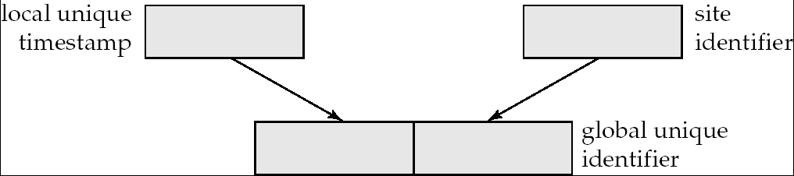
Timestamping
Timestamp based concurrency-control protocols can be used in distributed systems
Each transaction must be given a unique timestamp
Main problem: how to generate a timestamp in a distributed fashion:
  Each site generates a unique local timestamp using either a logical counter or the local clock.
  Global unique timestamp is obtained by concatenating the unique local timestamp with the unique identifier.

Slide 28
Timestamping (Cont.)
A site S_{i} with a slow clock will assign smaller timestamps
  Still logically correct: serializability not affected
  But: “disadvantages” transactions of the site S_{i}
To fix this problem:
  Define within each site S_{i} a logical clock (LC_{i}), which generates the unique local timestamp
  Require that S_{i} advance its logical clock whenever a request is received from a transaction T_{i} with timestamp < x,y> and x is greater that the current value of LC_{i}.
  In this case, site S_{i} advances its logical clock to the value x + 1.

Slide 29
Replication with Weak Consistency
Many commercial databases support replication of data with weak degrees of consistency (I.e., without a guarantee of serializability)
E.g.: master-slave replication: updates are performed at a single “master” site, and propagated to “slave” sites.
  Propagation is not part of the update transaction: it is decoupled
    May be immediately after transaction commits
    May be periodic
  Data may only be read at slave sites, not updated
    No need to obtain locks at any remote site
  Particularly useful for distributing information
    E.g. from central office to branch-office
  Also useful for running read-only queries offline from the main database

Slide 30
Replication with Weak Consistency (Cont.)
Replicas should see a transaction-consistent snapshot of the database
  That is, a state of the database reflecting all effects of all transactions up to some point in the serialization order, and no effects of any later transactions.
E.g. Oracle provides a create snapshot statement to create a snapshot of a relation or a set of relations at a remote site:
  Snapshot refresh either by recomputation or by incremental update
  Automatic refresh (continuous or periodic) or manual refresh

Slide 31
Multimaster and Lazy Replication
With multimaster replication (also called update-anywhere replication) updates are permitted at any replica, and are automatically propagated to all replicas
  Basic model: in distributed databases, where:
    transactions are unaware of the details of replication, and
    database system propagates updates as part of the same transaction
    Coupled with 2 phase commit
Many systems support lazy propagation where:
  Updates are transmitted after transaction commits
  Allows updates to occur even if some sites are disconnected from the network,
  But at the cost of consistency!

Slide 32
Deadlock Handling
Consider the following two transactions and history, with item X and transaction T₁ at site 1, and item Y and transaction T₂ at site 2:
T₁: write (X)
write (Y)
T₂: write (Y)
write (X)
X-lock on X
write (X)
X-lock on Y
write (Y)
wait for X-lock on X
Wait for X-lock on Y
Result: deadlock which cannot be detected locally at either site

Slide 33
Centralized Approach
A global wait-for graph is constructed and maintained in a single site; the deadlock-detection coordinator
  Real graph: Real, but unknown, state of the system.
  Constructed graph: Approximation generated by the controller during the execution of its algorithm .
the global wait-for graph can be constructed when:
  a new edge is inserted in or removed from one of the local wait-for graphs.
  a number of changes have occurred in a local wait-for graph.
  the coordinator needs to invoke cycle-detection.
If the coordinator finds a cycle, it selects a victim and notifies all sites. The sites roll back the victim transaction.

Slide 34
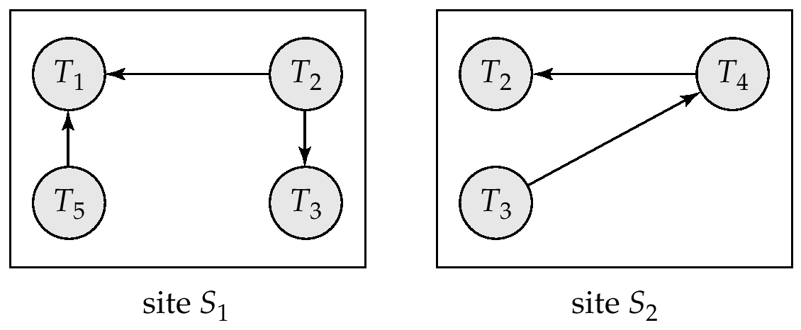
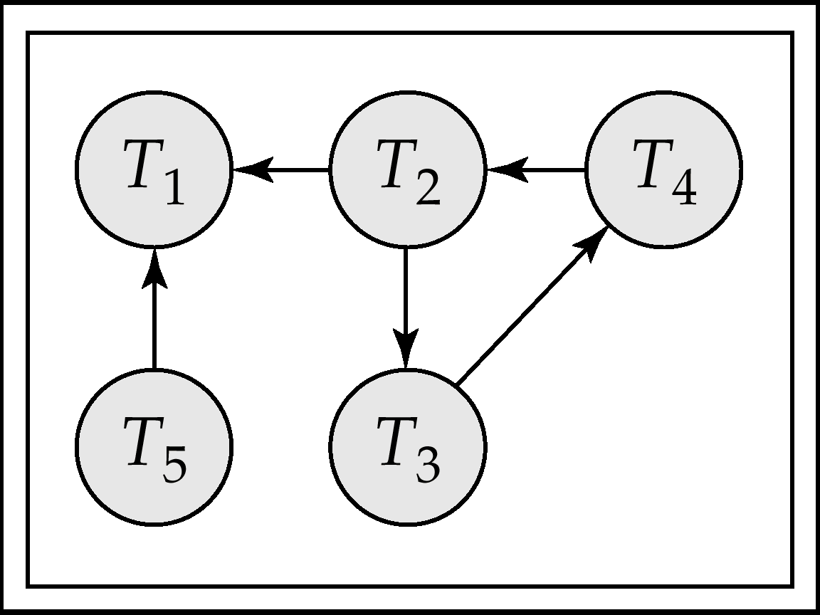
Local and Global Wait-For Graphs
Local
Global

Slide 35
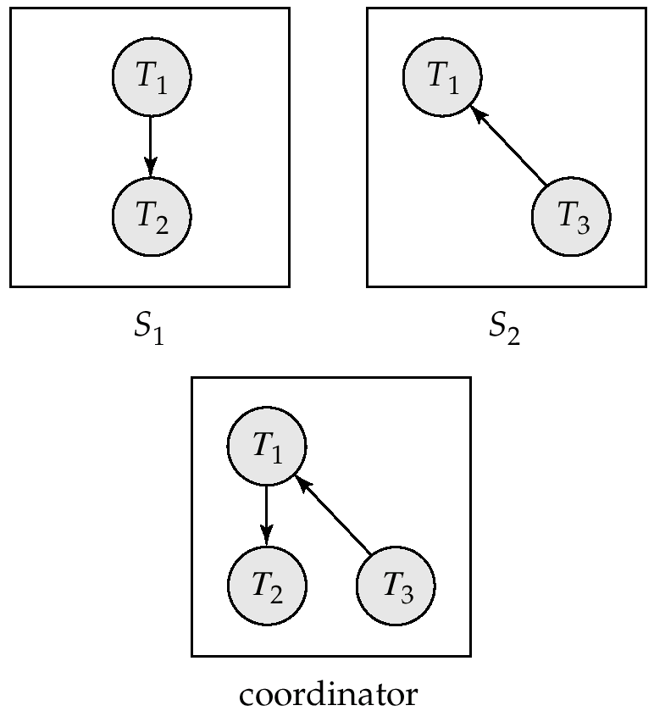
Example Wait-For Graph for False Cycles
Initial state:

Slide 36
False Cycles (Cont.)
Suppose that starting from the state shown in figure,
1. T₂ releases resources at S₁
    resulting in a message remove T₁ → T₂ message from the Transaction Manager at site S₁ to the coordinator)
2. And then T₂ requests a resource held by T₃ at site S₂
    resulting in a message insert T₂ → T₃ from S₂ to the coordinator
Suppose further that the insert message reaches before the delete message
  this can happen due to network delays
The coordinator would then find a false cycle
T₁ → T₂ → T₃ → T₁
The false cycle above never existed in reality.
False cycles cannot occur if two-phase locking is used.

Slide 37
Unnecessary Rollbacks
Unnecessary rollbacks may result when deadlock has indeed occurred and a victim has been picked, and meanwhile another of the transactions was aborted for reasons unrelated to the deadlock.
Unnecessary rollbacks can result from false cycles in the global wait-for graph;
  however, likelihood of false cycles is low.

Slide 38
Availability
High availability: time for which system is not fully usable should be extremely low (e.g. 99.99% availability)
Robustness: ability of system to function in spite of failures of components
Failures are more likely in large distributed systems
To be robust, a distributed system must:
  Detect failures
  Reconfigure the system so computation may continue
  Recover/reintegrate when a site or link is repaired
Failure detection: distinguishing link failure from site failure is hard
  (partial) solution: have multiple links, multiple link failure is likely a site failure

Slide 39
Reconfiguration
  Abort all transactions that were active at a failed site
    Making them wait could interfere with other transactions since they may hold locks on other sites
    However, in case only some replicas of a data item failed, it may be possible to continue transactions that had accessed data at a failed site.
  If replicated data items were at failed site, update system catalog to remove them from the list of replicas.
    This should be reversed when failed site recovers, but additional care needs to be taken to bring values up to date
  If a failed site was a central server for some subsystem, an election must be held to determine the new server
    E.g. name server, concurrency coordinator, global deadlock detector

Slide 40
Reconfiguration (Cont.)
Since network partition may not be distinguishable from site failure, the following situations must be avoided:
  Two or more central servers elected in distinct partitions
  More than one partition updates a replicated data item
Updates must be able to continue even if some sites are down
Solution: majority based approach
  Alternative of “read one write all available” is tantalizing but causes problems

Slide 41
Majority-Based Approach
The majority protocol for distributed concurrency control can be modified to work even if some sites are unavailable
  Each replica of each item has a version number which is updated when the replica is updated, as outlined below:
  A lock request is sent to at least ½ the sites at which item replicas are stored and operation continues only when a lock is obtained on a majority of the sites
  Read operations look at all replicas locked, and read the value from the replica with largest version number
    May write this value and version number back to replicas with lower version numbers (no need to obtain locks on all replicas for this task)

Slide 42
Majority protocol (Cont.)
  Write operations
    find highest version number like reads, and set new version number to old highest version + 1
    Writes are then performed on all locked replicas and version number on these replicas is set to new version number
  Failures (network and site) cause no problems as long as:
    Sites at commit contain a majority of replicas of any updated data items
    During reads a majority of replicas are available to find version numbers
    Subject to above, 2 phase commit can be used to update replicas
  Note: reads are guaranteed to see latest version of data item
  Reintegration is trivial: nothing needs to be done
Quorum consensus algorithm can be similarly extended

Slide 43
Site Reintegration
When failed site recovers, it must catch up with all updates that it missed while it was down
  Problem: updates may be happening to items whose replica is stored at the site while the site is recovering
  Solution 1: halt all updates on system while reintegrating a site
    Unacceptable disruption
  Solution 2: lock all replicas of all data items at the site, update to latest version, then release locks
    Other solutions with better concurrency also available

Slide 44
Comparison with Remote Backup
Remote backup systems (hot spare) are also designed to provide high availability
Remote backup systems are simpler and have lower overhead
  All actions performed at a single site, and only log records shipped
  No need for distributed concurrency control, or 2 phase commit
Using distributed databases with replicas of data items can provide higher availability by having multiple (> 2) replicas and using the majority protocol
  Also avoid failure detection and switchover time associated with remote backup systems

Slide 45
Coordinator Selection
Backup coordinators
  site which maintains enough information locally to assume the role of coordinator if the actual coordinator fails
  executes the same algorithms and maintains the same internal state information
  executes state information as the actual coordinator, if the actual coordinator fails
  allows fast recovery from coordinator failure but involves overhead during normal processing.
Election algorithms
  used to elect a new coordinator in case of failures
  Example: Bully Algorithm - applicable to systems where every site can send a message to every other site.

Slide 46
Bully Algorithm
If site S_{i} sends a request that is not answered by the coordinator within a time interval T, assumes that the coordinator has failed, S_{i} tries to elect itself as the new coordinator:
  S_{i} sends an election message to every site with a higher identification number,
  S_{i} then waits for any of these processes to answer within T,
  If no response within T, assumes that all sites with number greater than i have failed, S_{i} elects itself the new coordinator,
  If answer is received, S_{i} begins time interval T’, waiting to receive a message that a site with a higher identification number has been elected.
  If no message is received within T’, assumes the site with a higher number has failed; S_{i} restarts the algorithm.

Slide 47
Bully Algorithm (Cont.)
After a failed site recovers, it immediately begins execution of the same algorithm:
  If there are no active sites with higher numbers, the recovered site forces all processes with lower numbers to let it become the coordinator site,
  even if there is a currently active coordinator with a lower number.

Slide 48
Distributed Query Processing
For centralized systems, the primary criterion for measuring the cost of a particular strategy is the number of disk accesses.
In a distributed system, other issues must be taken into account:
  The cost of a data transmission over the network.
  The potential gain in performance from having several sites process parts of the query in parallel.

